Slide 1
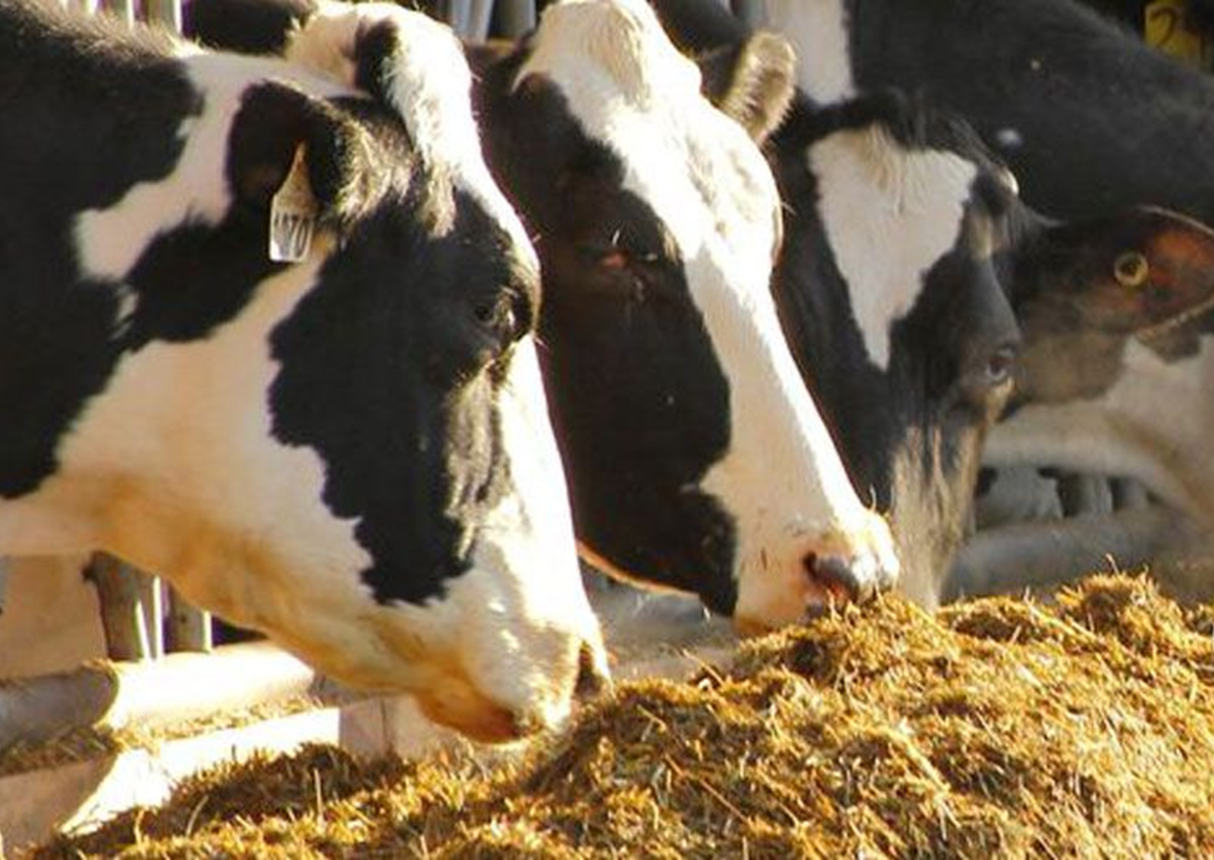
DDGS Feeding Trials in Thailand
Dr. Walter Chen
Dairy Nutrition Consultant

Slide 2
Background
There is an increasing demand in Southeast Asia for higher milk production and economic efficiency
Most of farms are feeding mixes of commercial concentrates that are consisted of mixes of byproducts and are of low-quality protein and energy
The objective of these feeding trials was to evaluate and demonstrate the benefits of feeding U.S. Imported DDGS to dairy cows in Thailand

Slide 3
Trial Farm Info

Slide 4
Cows and Trial Period
A total of 267 milking cows from four farms participated in this 8-week trial. The trial comprises three phases:
Pretrial (Week 1): Establish baseline milk yield data.
Transition Period (Week 2): Gradual introduction of DDGS to adapt cows to the new ration.
Treatment Period (Weeks 3–8): Full implementation of a treatment ration incorporating 1.5 kg DDGS per cow per day.
Each farm followed its unique ration, ensuring DDGS replaces existing protein concentrates, silage, or hay in the diet.

Slide 5
Feeding Management
TMR Feeding: Cows received Total Mixed Ration (TMR) twice daily.
Mixing Uniformity: TMR was mixed thoroughly with a controlled particle size to avoid excessively coarse or fine feed.
Feed Accessibility: Feeds were pushed up every two hours to ensure continuous access.
Feed Refusals: Feed refusals were weighed daily to determine actual intake.
Steady Feed Supply: Farms to maintain consistent feed availability.

Slide 6
Cow Management
Cohort Consistency: Cows remained in the same pen throughout the trial.
Exclusions: Cows that leave the herd (e.g., sold, dried off, deceased) are excluded, with relevant details recorded.
Inclusions: Fresh cows entering the herd are included.
Health Management: Sick cows are excluded from the trial entirely if they are removed from trial pens.

Slide 7
Data and Sample Collection
Milk Yield and Composition:
Record individual milk weights at each milking session.
Ensure milk meters are calibrated for accuracy.
Feed Refusals:
Weigh and record daily refusals to calculate actual feed intake.
TMR Sampling:
Collect a 500g TMR sample daily
Measure dry matter content by drying a 100g TMR sample in a forced-air oven at 135°C for two hours.
Data Recording:
Use the provided spreadsheet to document trial data, including cow numbers, feed intake and refusals, TMR particle size, daily individual cow milk yields if available and total milk production of the trial herd.

Slide 8
Trial Results

Slide 9
Farm #1
Milk yield increased from 11.5kg to high of 12.9kg
Due to the missing feed ingredient before the March 28th, milk yield didn’t change.
However, since March 28th, the owner has added the missing ingredient ground corn, milk yield had increased on average 0.58 kg per cow.

Slide 10
Farm#2
Milk yield increased from 11.6kg to the high of 15.4kg
Average for trial period is 14.08kg, up 3 kg

Slide 11
Soonbom Farm
Millk Yield increased from 11.3kg to the high of 14.5kg
Average for the trial period is 13.4kg, up 2.1kg

Slide 12
N&T Farm
Milk Yield increased from 21.5kg to the high of 24.9kg
Average milk yield increased by 2 kg or 9.3% during the trial period.
DMI increased 0.94kg during the trial period

Slide 13
Economic Analysis – IOFC at N&T Farm
Income over feed cost (IOFC) increased from 23,000 TBT to over 29,000 TBT per day
Average increase about 3,000 TBT per day

Slide 14
“Dollars and Sense” – IOFC at N&T Farm
Converting to US dollars, the IOFC (=income-feed cost) increased up to $826 per day, up $162 or 24% before the trail began.

Slide 15
Summary
Feeding US DDGS increased average milk production 2-3 liters per cow per day except for farm #1.
With the additional feed cost of DDGS, the IOFC still increased by $162 or 24% for N&T Farm
This means total annual increase of net profit of $59,130 for the farm or $591 each cow.

Slide 16
Conclusion
The DDGS trial clearly demonstrated the advantages of incorporating DDGS into the diets of dairy cows in Thailand.
Impressed by the results firsthand, the trial farm owners have chosen to continue using DDGS even after the conclusion of the sponsored trial.

